Slide 1

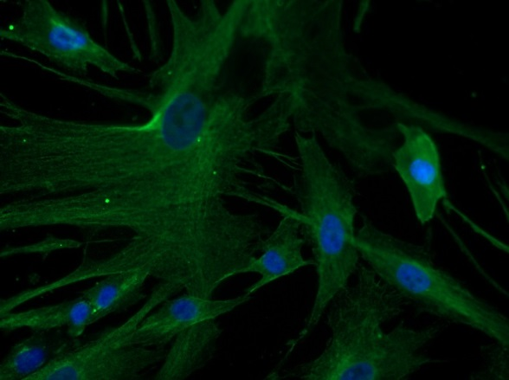
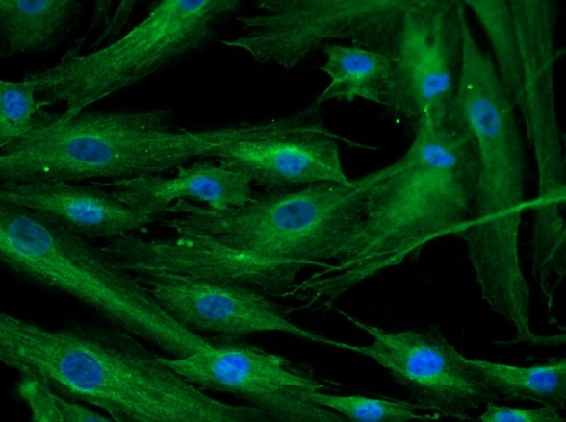
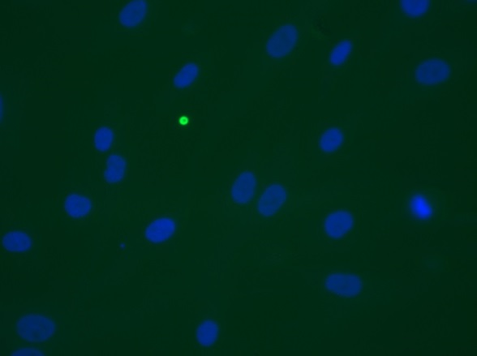
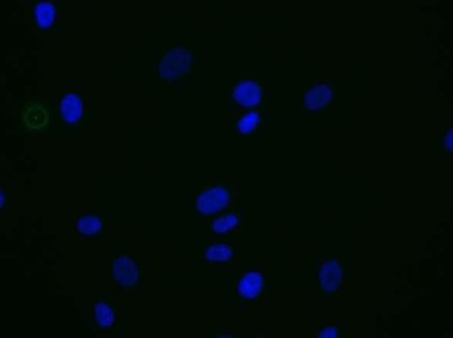
ReliaTech GmbH
Mouse anti-human PlGF #3B10
mouse anti-human PlGF
mouse anti-human PlGF
Control (goat anti-mouse IgG ALEXA Flour 488; 1:600)
Immunofluorescence staining of PlGF in primary human dermal fibroblast cells (HDNF) with monoclonal mouse anti-human PlGF #3B10 [Cat# 101-M65] (upper panel). Control with goat anti-mouse ALEXA Flour 488 [Dianova] (lower panel).
[IF_NHDF1406-02; 101-M65 [10µg/ml] 400X]
http://www.reliatech.de / orders@reliatech.de

